Slide 1

YZY Language School
Ying HAO
Yaowu HUANG
Zhiwei LI
APR 08, 2021

Slide 2

Agenda
Services and System Functions
Technologies and Challenges
Database Design
Mockup

Slide 3
Functions related with Course - Multi-Language Support: English, French, Mandarin - Register/Cancel Courses - Manage assignment and grade - Search by key-words/time/language: course, teacher - Course Time: day or night of weekdays, weekends, summer camp, etc. - Course Type: small class, one-to-one class, on-line class, etc. - Payment Modules - Student Application - register courses, cancel courses, payment - School Application - Teacher (course time, assignment, grade) - Library - all common shared functionalities

Slide 4
Technologies - WPF - Entity Framework - RDBMS: Table, View, Procedure, … - C#: Generic/Type, Collection, Lambda, LINQ, Threading - 2D drawing (chart) - Unit Test - MVP design pattern Challenges - Thread Safe - Responsive UI - String translation - Drawing pie chart / bar chart for the reports - MVP architecture with WPF and Entity Framework (if have time)

Slide 5
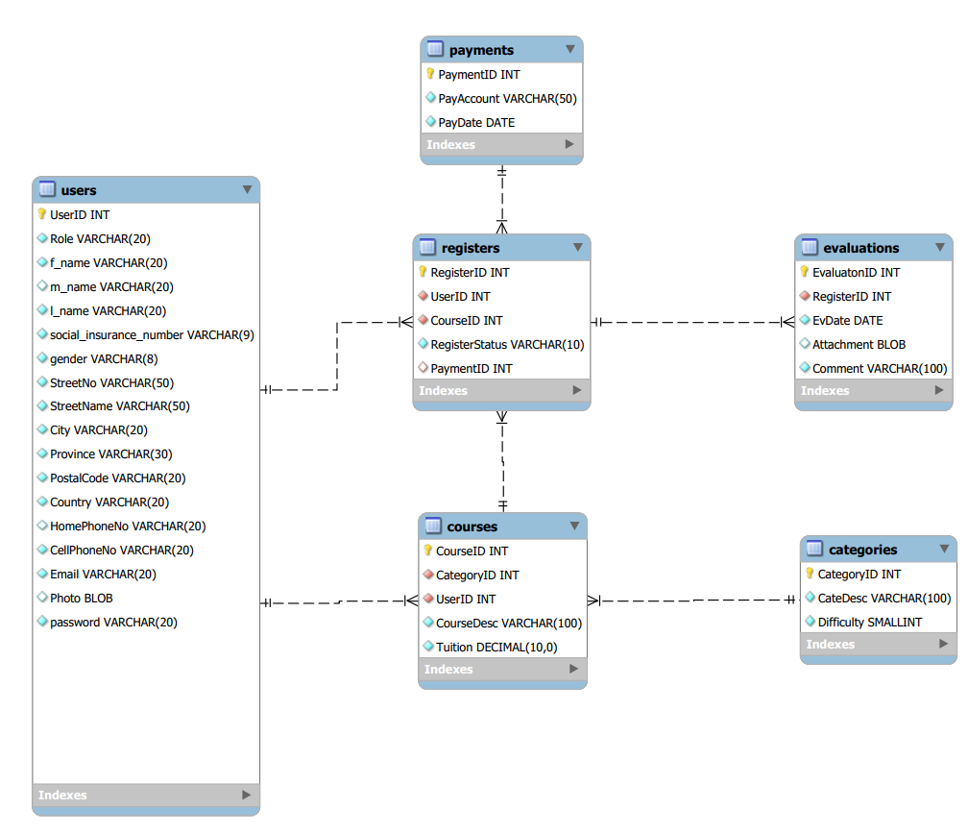

Database Design

Slide 6
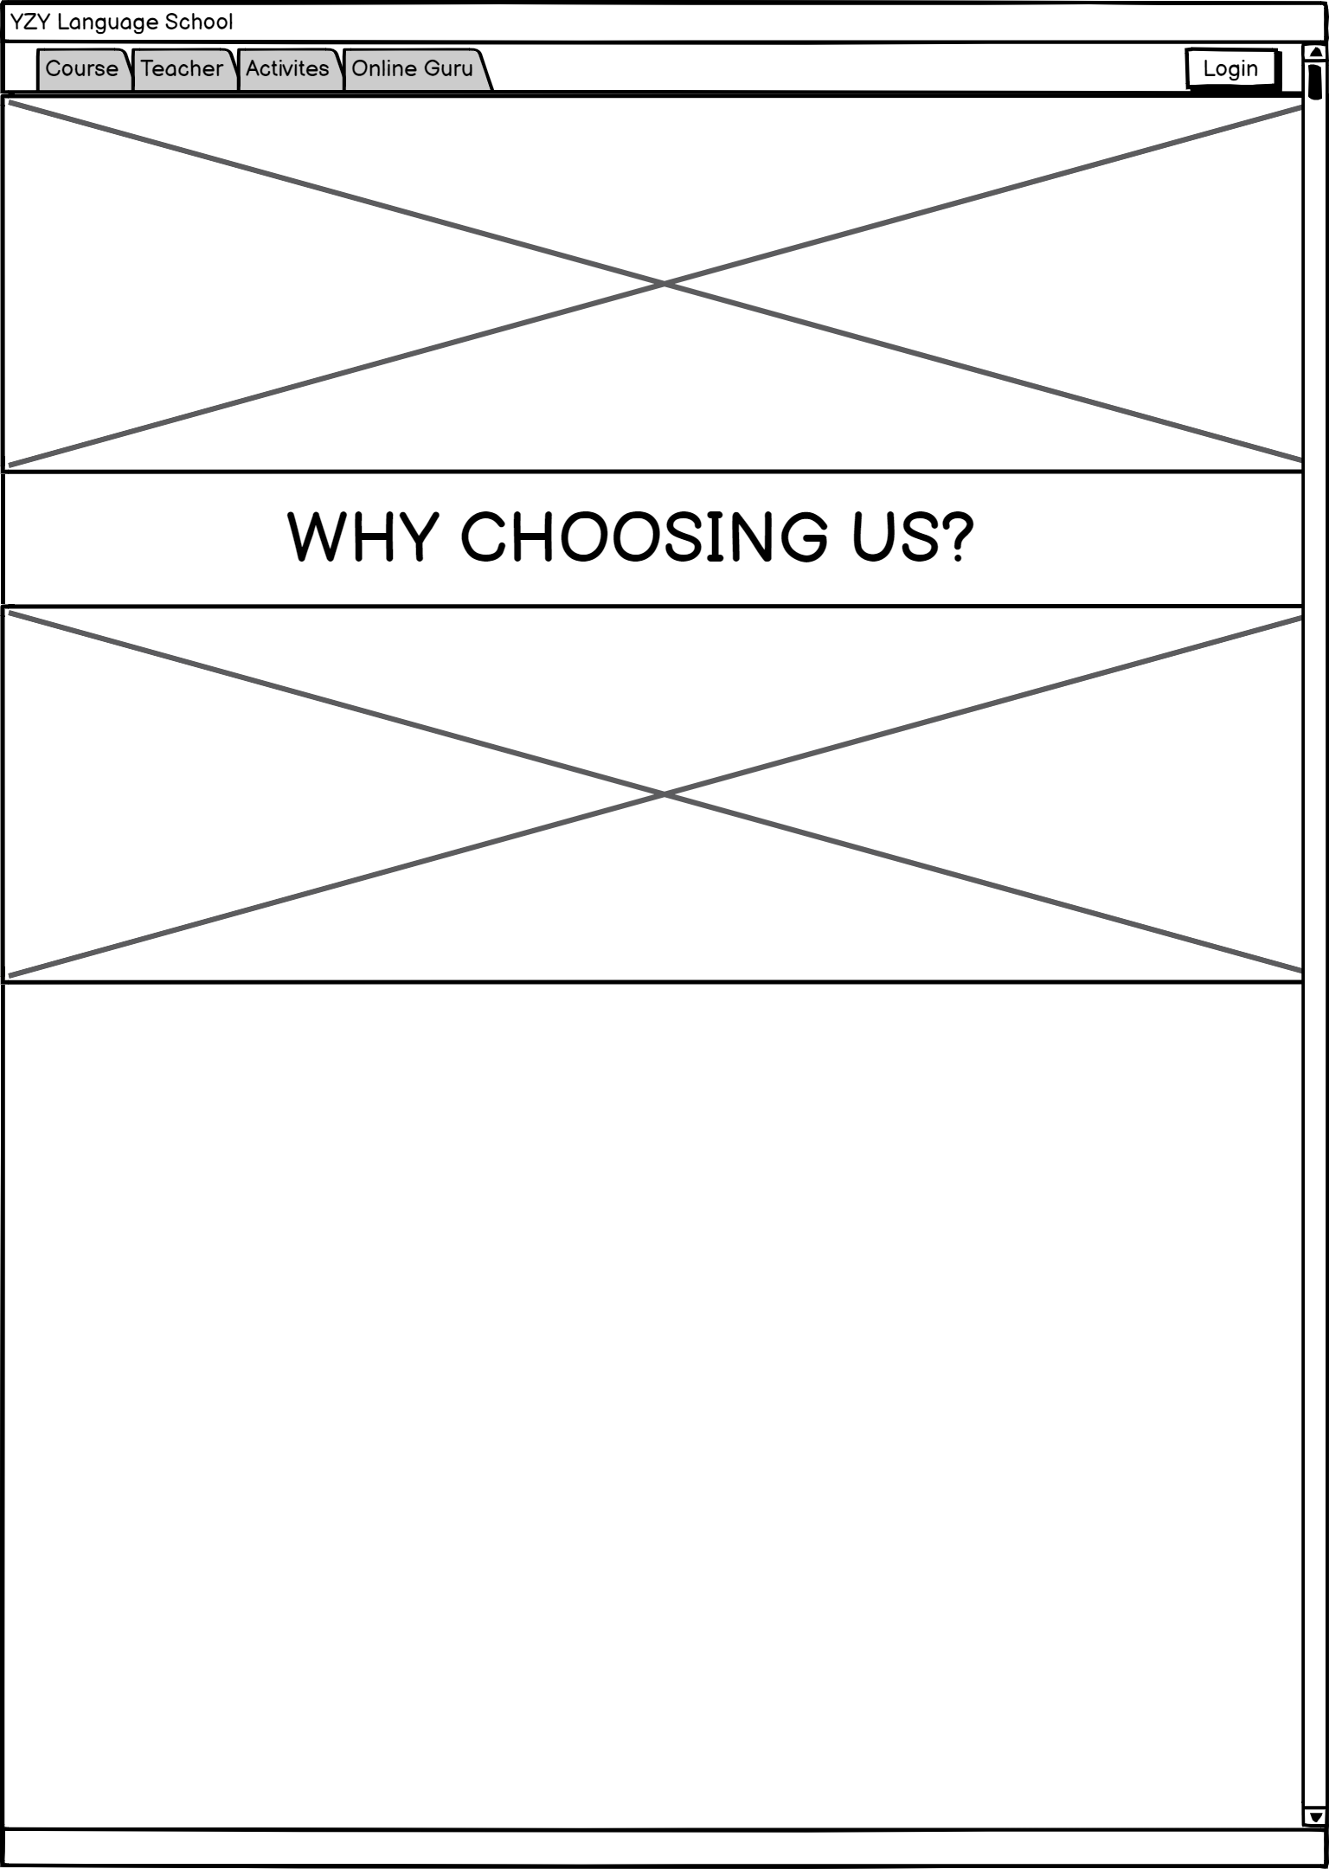
Mockup

Slide 7
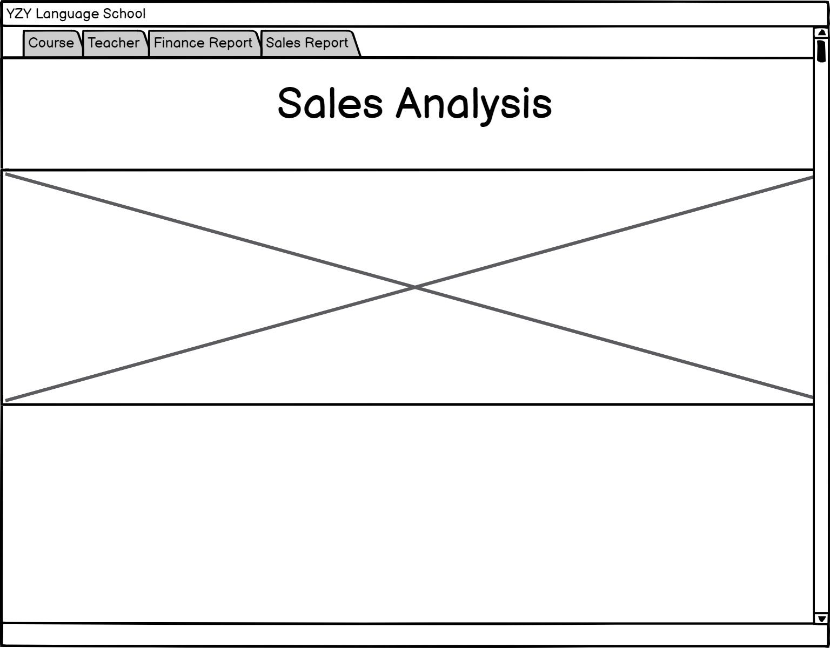
Mockup

Slide 8
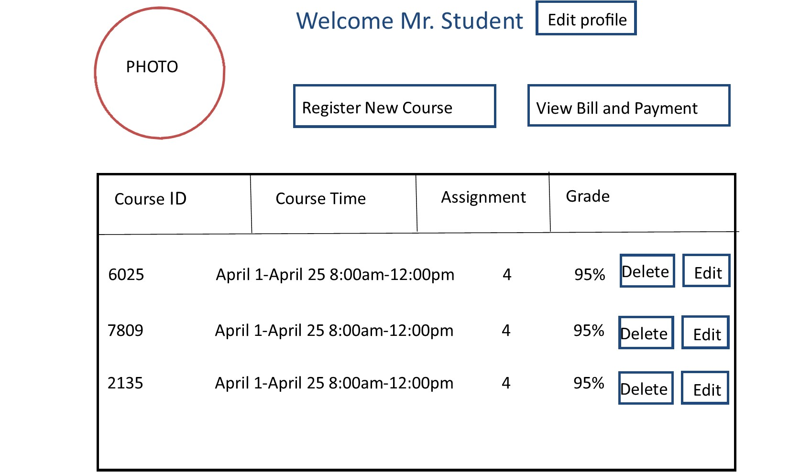
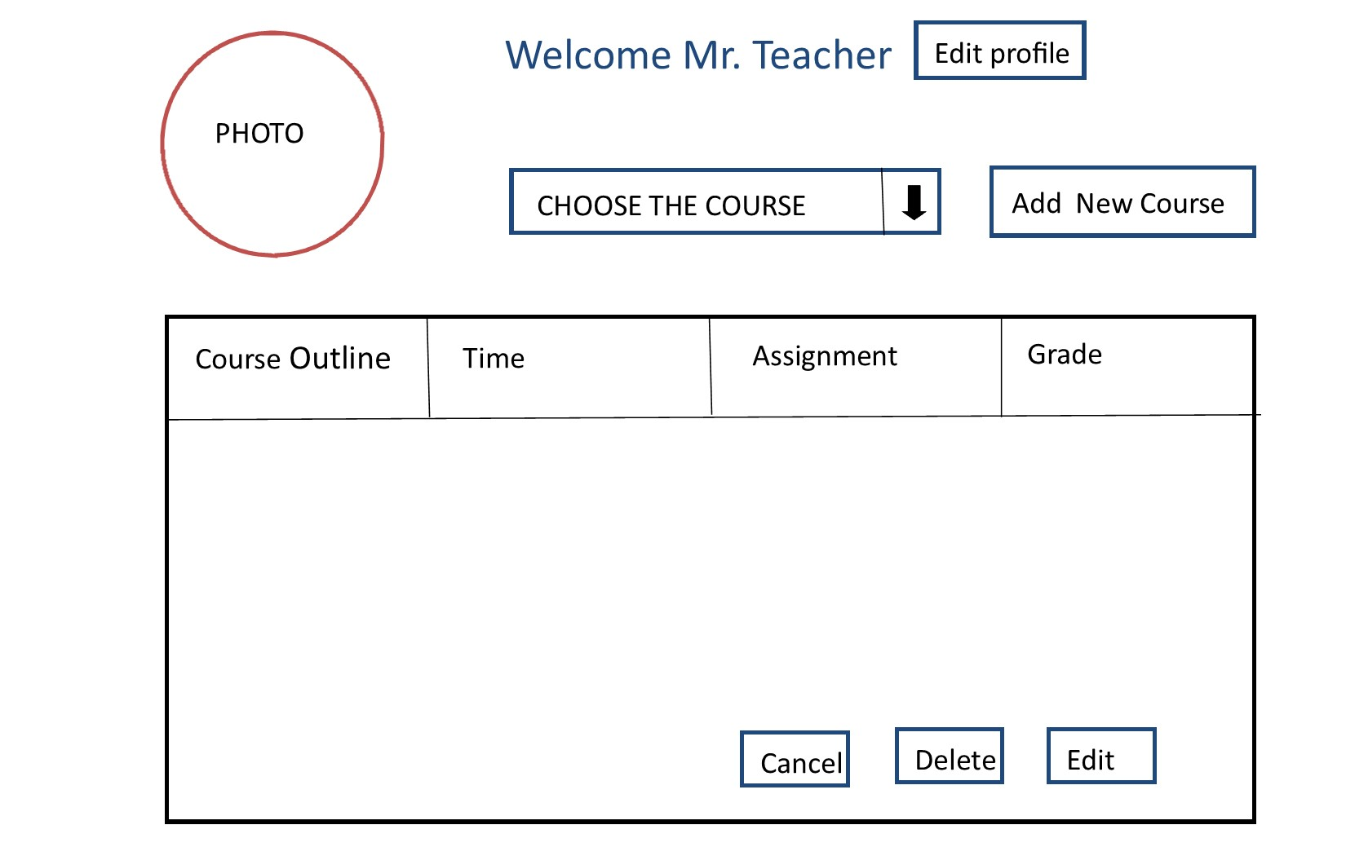
Mockup

